Slide 1
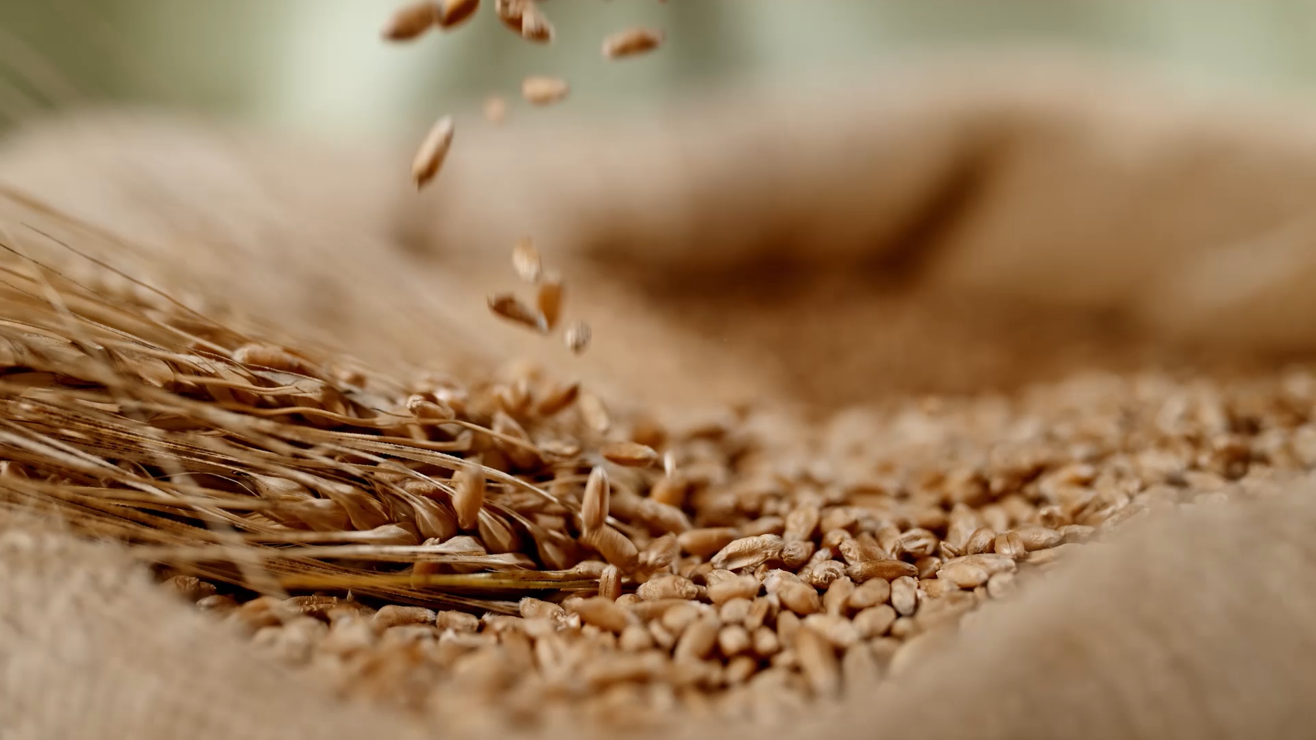
Revolutionizing Indoor Farming
Introducing the Autonomous Indoor Farming Platform
A smarter way to grow plants using technology
By: Abdullah Ahmad, Nil Boyraz, Sadia Waheed, Eray Elvan
Supervisor: Melih Türkseven

Slide 2
The Big Problem
Traditional hydroponics is labor-intensive
Manual checks for pH and nutrients
Time-consuming and prone to errors
Deep Water Culture (DWC) lacks automation
Small farmers and hobbyists need a simpler, automated solution

Slide 3

Our Vision
Create a fully autonomous hydroponic system
Self-regulates pH and nutrients
Monitors remotely via IoT
Minimal human intervention
Affordable for small-scale use

Slide 4
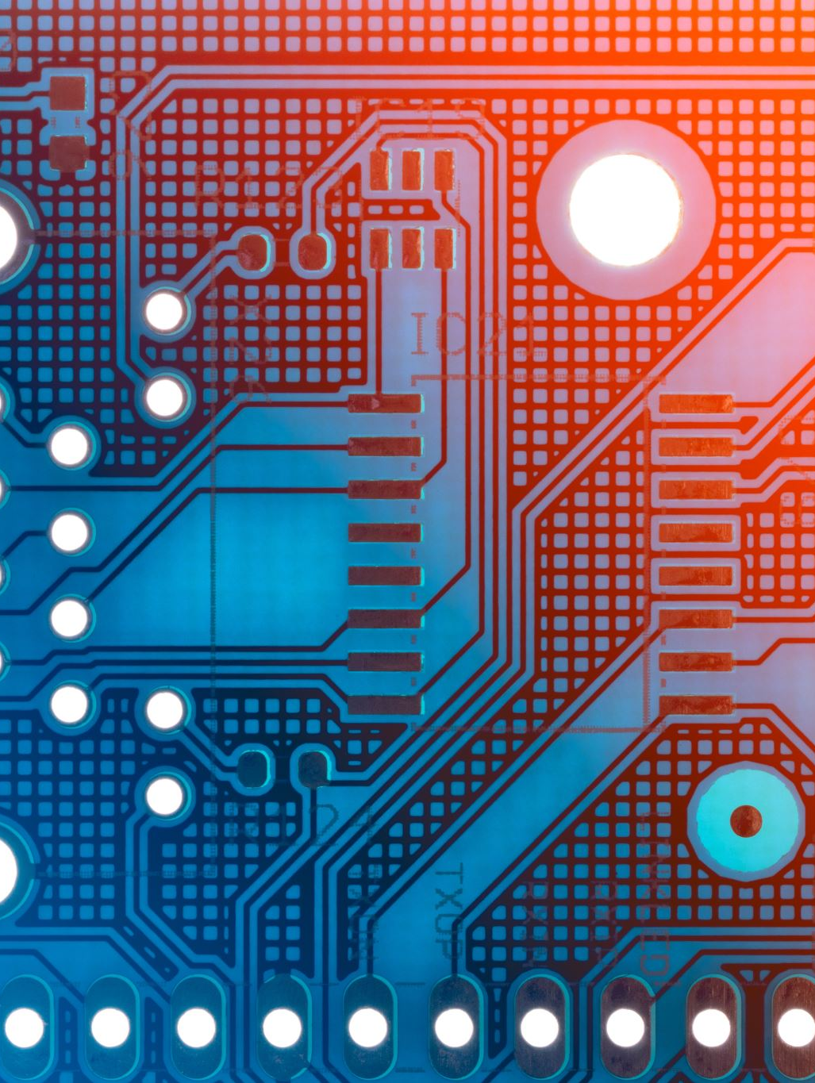
The Technology Behind the Magic
Key Components
Sensors: Measure pH and nutrient levels
Microcontrollers: Arduino Uno for automation, ESP8266 for IoT
Pumps: Adjust pH and nutrient levels automatically
IoT Integration: Real-time and historic sensor data on your device

Slide 5
How It Works
Sensors Detect: pH and nutrient levels in water
Arduino Analyzes: Decides if adjustments are needed
Pumps Activate: Dispense solutions to restore balance
Data Shares: IoT displays stats in real-time

Slide 6
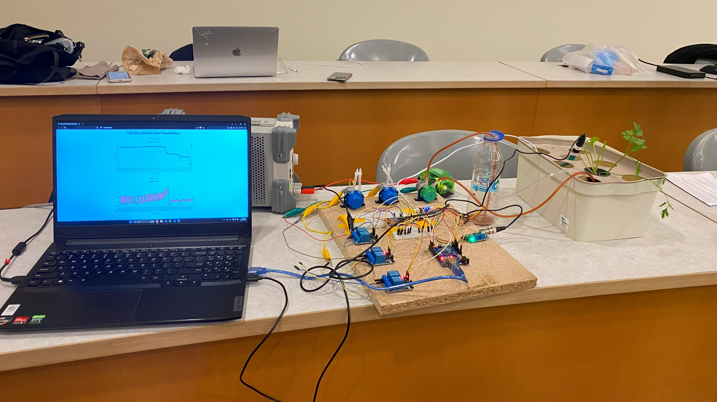
Our setup

Slide 7
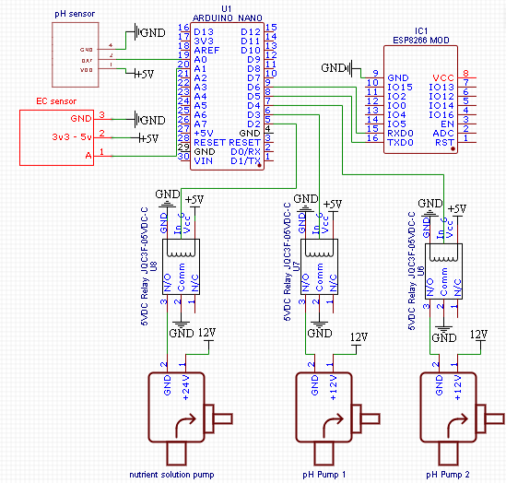
Our schematic

Slide 8
Thresholds for the EC and pH
For EC (Electrical Conductivity) of parsley, different values were recommended but a safe value was determined to be around 1500 µS/cm.
However, our Arduino, for some reason displayed till 1038 µS/cm.
Modified it by reducing the value by 10.
pH value should be between 5.5 and 6.5
https://ponicslife.com/hydroponic-charts-for-fruits-and-vegetables-ph-tds-ec-cf-ppm/
https://extension.okstate.edu/fact-sheets/electrical-conductivity-and-ph-guide-for-hydroponics.html

Slide 9
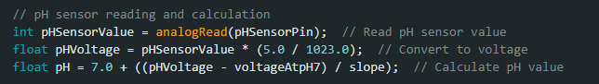
Calibrating the pH sensor
We used ChatGPT to calibrate the sensor for us as solutions available online were not working well with our sensor
These calculations were used along with the control solution to verify our findings. This worked the best
The value for “voltageAtpH7” was a constant that we set to 3.15.

Slide 10
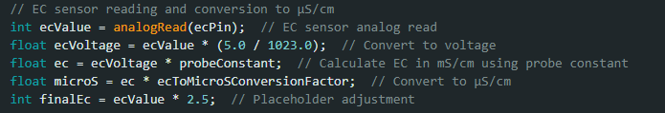
Calibrating the EC sensor
We again used ChatGPT for this as online guides were not suitable for our sensor model.
An image of the sensor was provided to GPT, and it was able to identify the model and provide accurate calculations
The reading was reduced by a scale of 10 as the reading from the Arduino was capped around 1038 µS/cm.
The placeholder adjustment was used during our calibration with bottled water to achieve the correct EC value. This calculation even worked in our final tests

Slide 11
What We Achieved
Automation: Minimal human input needed
Precision: Accurate pH and nutrient regulation
Connectivity: Real-time monitoring via IoT
Healthy Growth: Plants thrive with optimal conditions

Slide 12
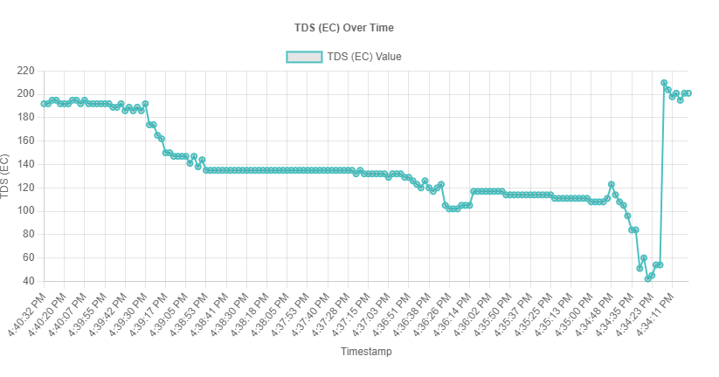

Slide 13
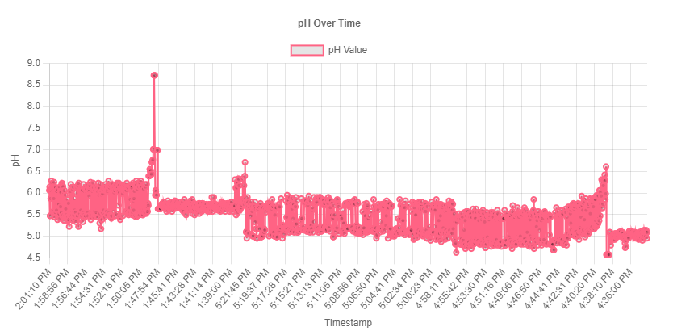
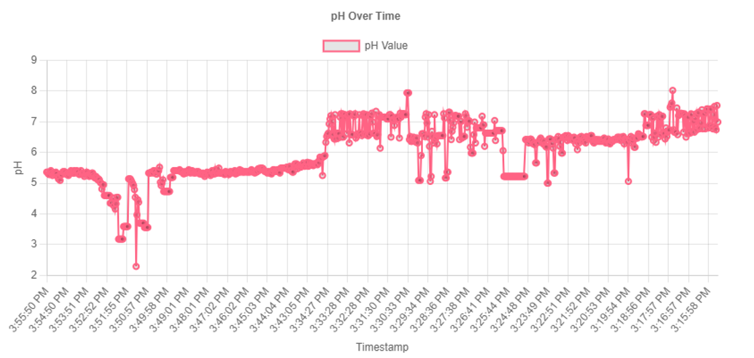
Issues with the pH sensor
Variance in data is not fixed
Right chart shows low variance
Left chart shows high variance
Reading (with variance) Is not constant

Slide 14
The Impact
For Farmers: Saves time and effort
For Science: Advances IoT in agriculture
For Society: Affordable tech for sustainable farming

Slide 15
Challenges and Future Goals
Fine-tuning sensor accuracy
Ensuring long-term reliability
Next Steps:
Test with diverse plants and conditions
Scale up for larger systems
Explore additional features like automated lighting

Slide 16
Thank You!
Let’s reimagine farming together!
Questions?

